Slide 1
Safe Haven
A secure, anonymous, and accessible platform empowering survivors of gender-based violence to find safety, seek justice, and begin healing.
Gender-Based Violence Support Initiative
Powered by Technology & Compassion

Slide 2
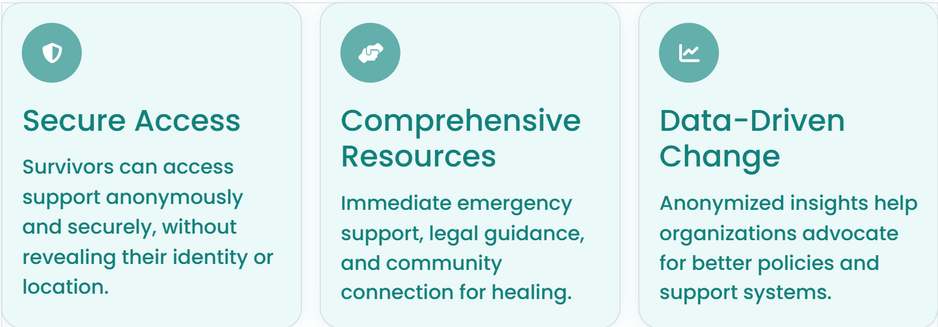
Mission

Slide 3
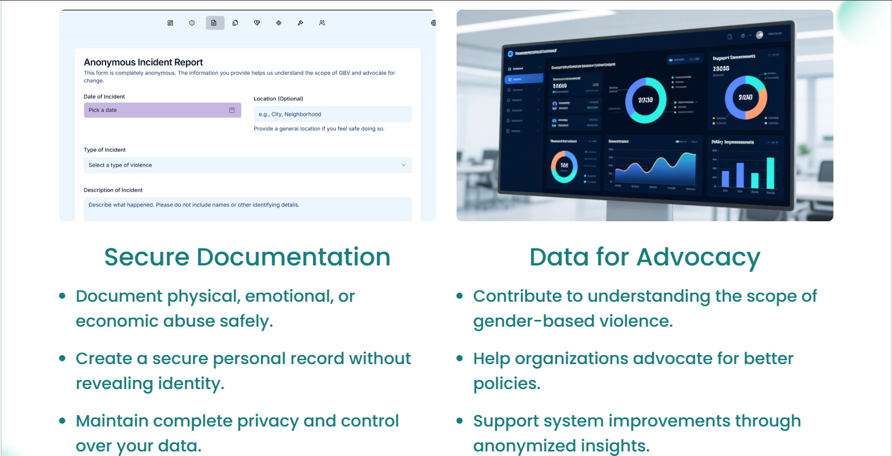
Anonymous Incident Reporting

Slide 4
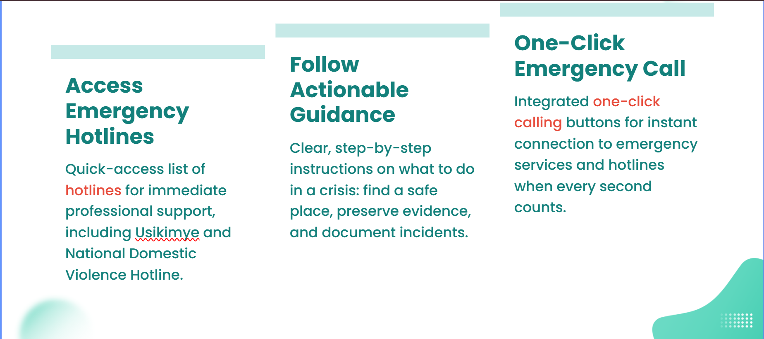
Immediate Help in a Crisis

Slide 5
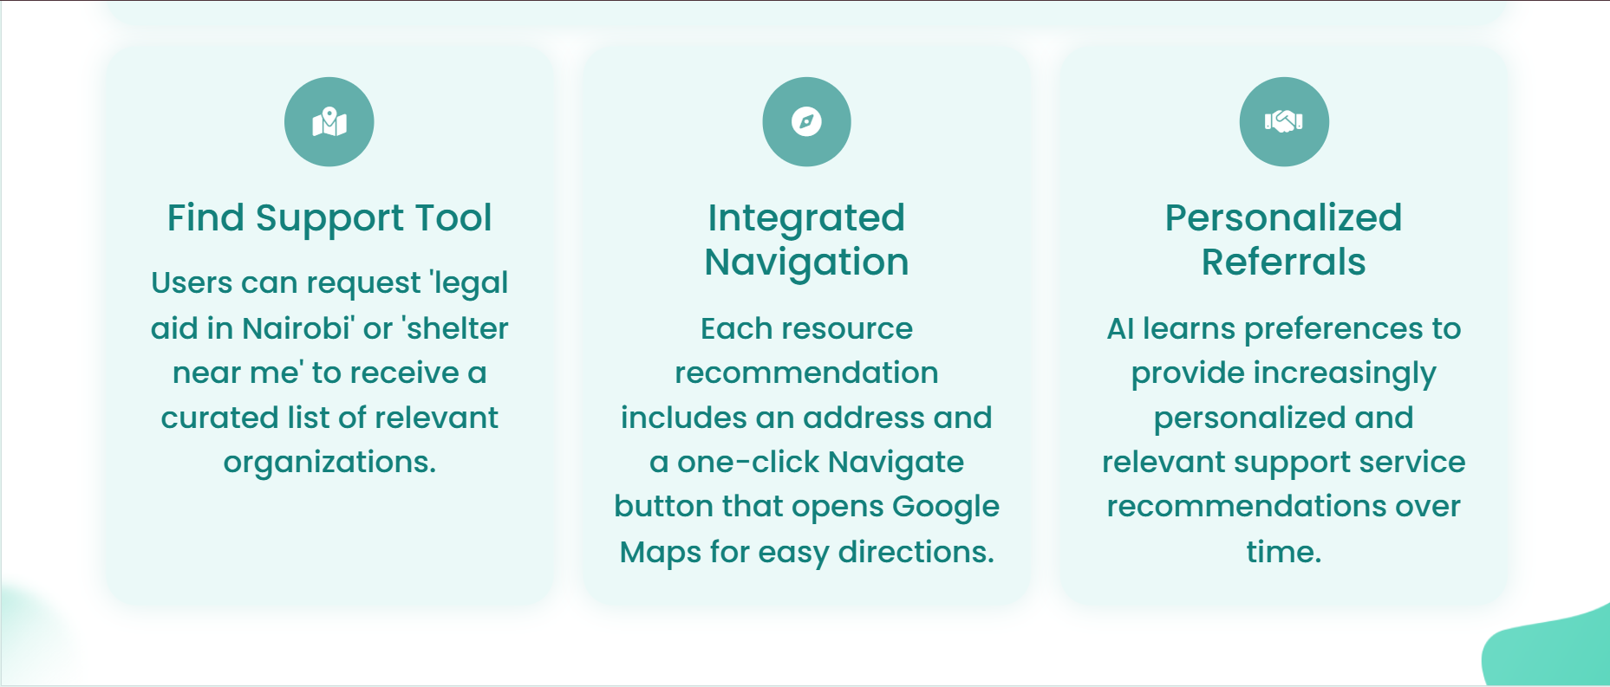
AI-Powered Support Network
Intelligent Resource Connection
Our Genkit-powered AI connects users with local support services tailored to their location and specific needs, ensuring relevant and accessible help.

Slide 6
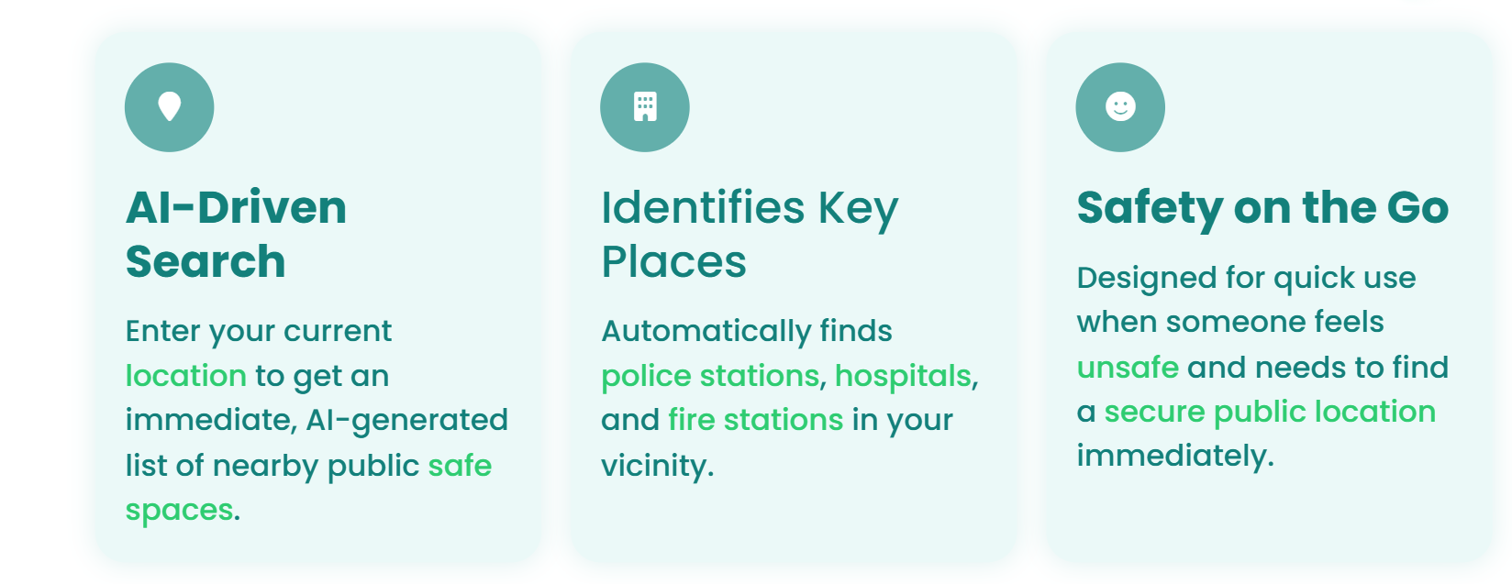
Find Nearby Safe Locations

Slide 7
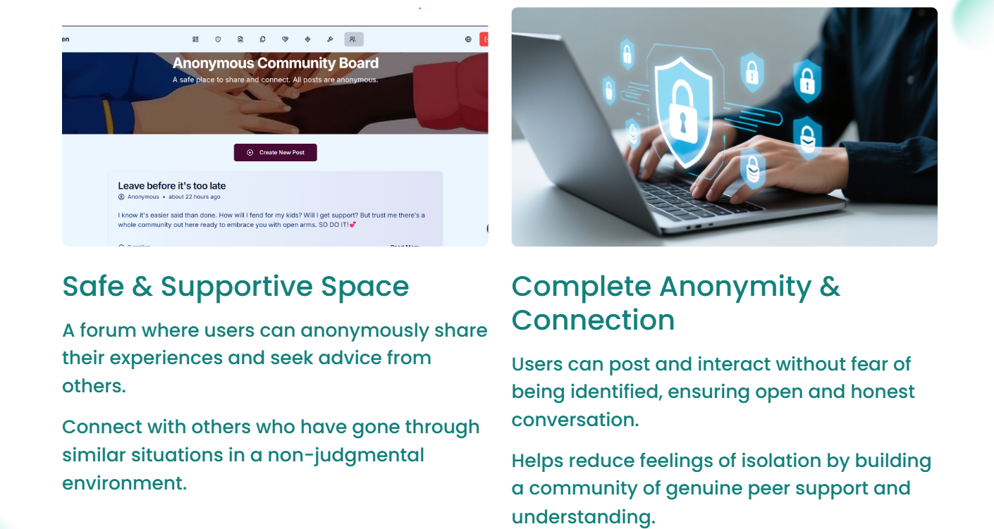
Anonymous Community Board

Slide 8
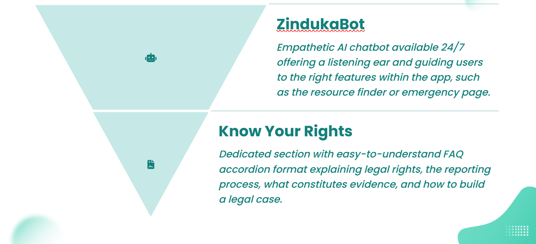
AI Support & Legal Empowerment

Slide 9

Technology Stack
Built on Modern, Secure Infrastructure
SafeHaven leverages cutting-edge technologies to ensure security, accessibility, and reliable performance for all users.

Slide 10


